Slide 1
HASHING
Course teacher: Moona Kanwal

Slide 2
Hashing
Mathematical concept
  To define any number as set of numbers in given interval
  To cut down part of number
  Used in discreet maths, e.g graph theory, set theory
  Used in Searching technique
  Used in encryption methods

Slide 3
Hash Functions and Hash Tables
Hashing has 2 major components
  Hash function h
  Hash Table Data Structure of size N
A hash function h maps keys (a identifying element of record set) to hash value or hash key which refers to specific location in Hash table
Example:
h(x) = x mod N
is a hash function for integer keys
The integer h(x) is called the hash value of key x

Slide 4
Hash Functions and Hash Tables
A hash table data structure is an array or array type ADTof some fixed size, containing the keys.
An array in which records are not stored consecutively - their place of storage is calculated using the key and a hash function
hash function
array index
Key

Slide 5
Hashed key: the result of applying a hash function to a key
Keys and entries are scattered throughout the array
Contains the main advantages of both Arrays and Trees
Mainly the topic of hashing depends upon the two main factors / parts
(a) Hash Function (b) Collision Resolution
Table Size is also an factor (miner) in Hashing, which is 0 to tablesize-1.

Slide 6
Table Size
Hash table size
  Should be appropriate for the hash function used
  Too big will waste memory; too small will increase collisions and may eventually force rehashing (copying into a larger table)

Slide 7
Example
We design a hash table for a dictionary storing items (SSN, Name), where SSN (social security number) is a nine-digit positive integer
The actual data is not stored in hash table
Pin points the location of actual data or set of data
Our hash table uses an array of size N = 10,000 and the hash function
h(x) = last four digits of x
0
∅
1
025-612-0001
2
981-101-0002
3
∅
4
451-229-0004
…
9997
∅
9998
200-751-9998
9999
∅

Slide 8
Hash Function
The mapping of keys into the table is called Hash Function
A hash function,
  Ideally, it should distribute keys and entries evenly throughout the table
  It should be easy and quick to compute.
  It should minimize collisions, where the position given by the hash function is already occupied
  It should be applicable to all objects

Slide 9
Different types of hash functions are used for the mapping of keys into tables.
(a) Division Method
(b) Mid-square Method
(c) Folding Method

Slide 10
1. Division Method
Choose a number m larger than the number n of keys in k.
The number m is usually chosen to be a prime no.
The hash function H is defined as,
H(k) = k(mod m) or H(k) = k(mod m) + 1
Denotes the remainder, when k is divided by m
2nd formula is used when range is from 1 to m.

Slide 11
Example:
Elements are: 3205, 7148, 2345
Table size: 0 – 99 (prime)
m = 97 (prime)
H(3205)= 4, H(7148)=67, H(2345)=17
For 2nd formula add 1 into the remainders.

Slide 12
2. Folding Method
The key k is partitioned into no. of parts
Then add these parts together and ignoring the last carry.
One can also reverse the first part before adding (right or left justified. Mostly right)
H(k) = k1 + k2 + ………. + kn

Slide 13
Example:
H(3205)=32+05=37 or H(3250)=32+50=82
H(7148)=71+43=19 or H(7184)=71+84=55
H(2345)=23+45=77 or H(2354)=23+54=68

Slide 14
3. Mid-Square Method
The key k is squared. Then the hash function H is defined as
H(k) = l
The l is obtained by deleting the digits from both ends of K^{2.}
The same position must be used for all the keys.

Slide 15
Example:
k: 3205 7148 2345
k²: 10272025 51093904 5499025
H(k): 72 93 99
4th and 5th digits have been selected. From the right side.

Slide 16
Collision Resolution Strategies
If two keys map on the same hash table index then we have a collision.
As the number of elements in the table increases, the likelihood of a collision increases - so make the table as large as practical
Collisions may still happen, so we need a collision resolution strategy

Slide 17
Two approaches are used to resolve collisions.
(a) Separate chaining: chain together several keys/entries in each position.
(b) Open addressing: store the key/entry in a different position.
Probing: If the table position given by the hashed key is already occupied, increase the position by some amount, until an empty position is found

Slide 18
Open Addressing
Types of open addressing are
1. Linear Probing
2. Quadratic Probing
3. Double Hashing.

Slide 19
1. Linear Probing
Locations are checked from the hash location k to the end of the table and the element is placed in the first empty slot
If the bottom of the table is reached, checking “wraps around” to the start of the table. Modulus is used for this purpose
Thus, if linear probing is used, these routines must continue down the table until a match or empty location is found

Slide 20
Linear probing is guaranteed to find a slot for the insertion if there still an empty slot in the table.
Even though the hash table size is a prime number is probably not an appropriate size; the size should be at least 30% larger than the maximum number of elements ever to be stored in the table.
If the load factor is greater than 50% - 70% then the time to search or to add a record will increase.

Slide 21
H(k)=h, h+1, h+2, h+3,……, h+I
However, linear probing also tends to promote clustering within the table.
1
2
3
4
5
6
7
8

Slide 22
2. Quadratic Probing
Quadratic probing is a solution to the clustering problem
  Linear probing adds 1, 2, 3, etc. to the original hashed key
  Quadratic probing adds 1², 2², 3² etc. to the original hashed key
However, whereas linear probing guarantees that all empty positions will be examined if necessary, quadratic probing does not

Slide 23
If the table size is prime, this will try approximately half the table slots.
More generally, with quadratic probing, insertion may be impossible if the table is more than half-full!
H(k) = h, h+1, h+4, h+5, h+6,……, h+i²

Slide 24
3. Double Hashing
2nd hash function H’ is used to resolve the collision.
Here H’(k) = h’ ≠ m
Therefore we can search the locations with addresses,
H’(k) = h, h+h’, h+2h’, h+3h’,…….
If m is prime, then this sequence access all the locations.

Slide 25
Double Hashing
Double hashing uses a secondary hash function d(k) and handles collisions by placing an item in the first available cell of the series
(h + jd(k)) mod N
for j = 0, 1, … , N − 1
The secondary hash function d(k) cannot have zero values
The table size N must be a prime to allow probing of all the cells
Common choice of compression map for the secondary hash function: d₂(k) = k mod q
where
  q < N
  q is a prime
The possible values for d₂(k) are
1, 2, … , q

Slide 26
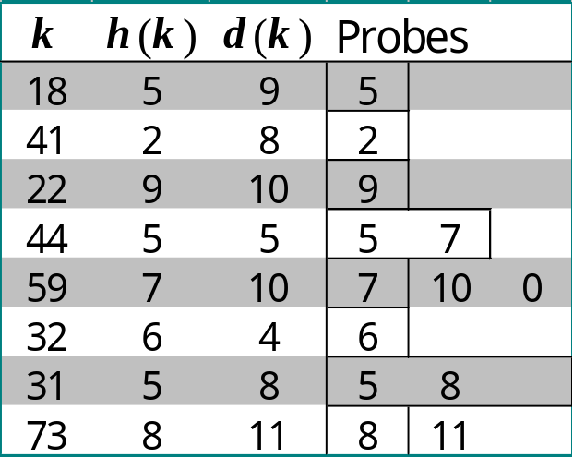
Example of Double Hashing
Consider a hash table storing integer keys that handles collision with double hashing
  N = 13
  h(k) = k mod 13
  d(k) = k mod 7
Insert keys 18, 41, 22, 44, 59, 32, 31, 73, in this order
0
1
2
3
4
5
6
7
8
9
10
11
12
59
41
18
32
44
8
22
44
11
0
1
2
3
4
5
6
7
8
9
10
11
12

Slide 27
Applications of Hashing
Compilers use hash tables to keep track of declared variables
A hash table can be used for on-line spelling checkers — if misspelling detection (rather than correction) is important, an entire dictionary can be hashed and words checked in constant time
Game playing programs use hash tables to store seen positions, thereby saving computation time if the position is encountered again
Hash functions can be used to quickly check for inequality — if two elements hash to different values they must be different

